Slide 1
Natural Language Processing (NLP)
by M.Z.

Slide 2
Outline
NLP Intro
Examples
Basic Commands
Tokenization
Stemming & Lemmatization
Stop Words
POS-Tag
Advanced
Sentiment Analysis
Limitations & Future
Conclusion

Slide 3


What is NLP?
Definition: “a subfield of linguistics, computer science, information engineering, and artificial intelligence where the goal is to be able to get machines (computers) to understand the meaning of human (natural) language. “ (Wikipedia)
Hello!
...Hi!
Notes:
Linguistics: study of language (sound and meaning), CS: computation and information, I.E.:generation, distribution, analysis, and use of information, data, and knowledge in systems AI: intelligence demonstrated by machines

Slide 4
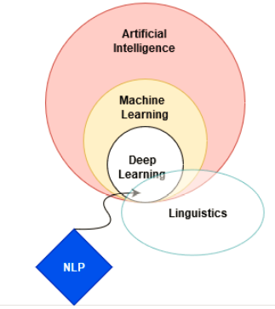
High Level Structure
Artificial Intelligence: concerned with making computers intelligent (less reliant on human instruction).
Machine Learning: set of tools for making inference and predictions (computer science and statistics).
Deep Learning: special area of ML where a lot more data is required to establish relationships strengths (text/pics) uses multiple layers to progressively extract higher level features from the raw input (edges→ shape -> identify object).
We have complex problems (language)
Lots of data that we can feed into the model
Linguistics: study of language through sound and meaning.
Notes:
Linguistics: study of language (sound and meaning), CS: computation and information, I.E.:generation, distribution, analysis, and use of information, data, and knowledge in systems AI: intelligence demonstrated by machines

Slide 5
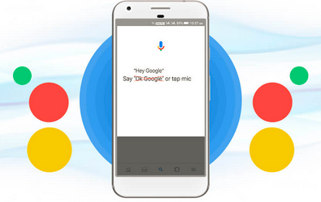


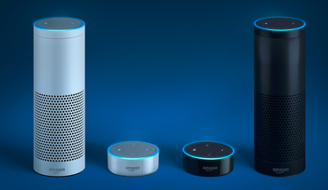
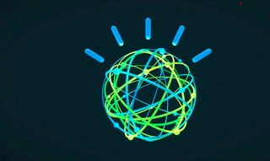
Problems Solved with NLP
Voice Driven Interfaces

Slide 6


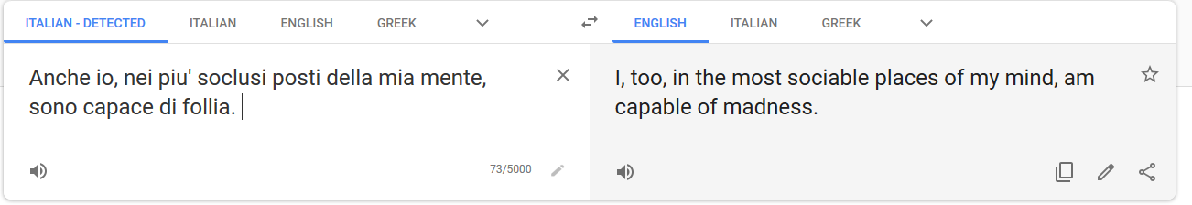

Problems Solved with NLP
Machine Translation
SECLUSI

Slide 7

Why is it important?
NLP processing helps computers communicate with humans in their own language and scales other language-related tasks.
read text, hear speech, interpret it, measure sentiment and determine which parts are important.
Machines can analyze more language-based data than humans, without fatigue and in a consistent, unbiased way.
More efficient & less biased

Slide 8
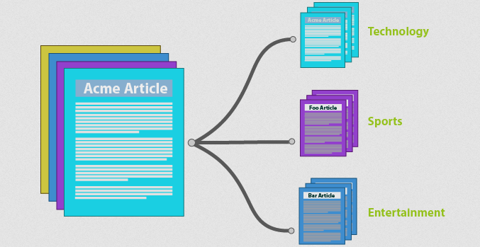
Problems Solved with NLP
Document Categorization

Slide 9





Problems Solved with NLP
Search Engines
many more….

Slide 10


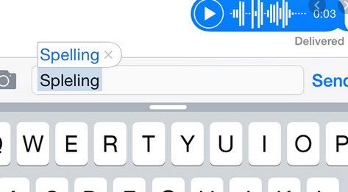

Problems Solved with NLP
Spell Checker (autocomplete, autocorrect)

Slide 11


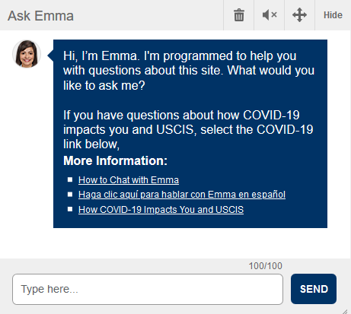

Problems Solved with NLP
Robot Chat

Slide 12
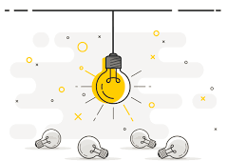
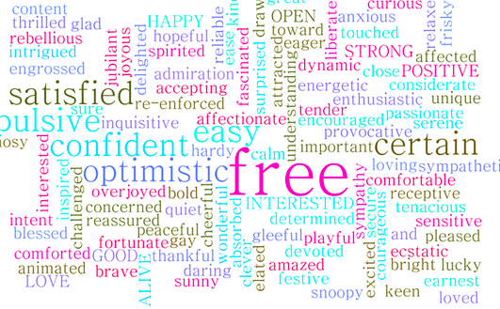

Major Pillars of NLP
Content categorization. A linguistic-based document summary, including search and indexing, content alerts and duplication detection.
Topic discovery and modeling. Accurately capture the meaning and themes in text collections, and apply advanced analytics to text, like optimization and forecasting.
Contextual extraction. Automatically pull structured information from text-based sources.
Sentiment analysis. Identifying the mood or subjective opinions within large amounts of text, including average sentiment and opinion mining.
Speech-to-text and text-to-speech conversion. Transforming voice commands into written text, and vice versa.
Document summarization. Automatically generating synopses of large bodies of text.
Machine translation. Translating file/voice input from one language to the other

Slide 13
Basic Functions
Packages
Tokenization
Stemming
Lemmatization
Stop Words
Part-of-speech tagging
Sentiment Analysis

Slide 14
Packages
Data Frame Manipulation (selection, deletion, sorting…)
Numpy
Pandas
Data Processing (specific operation pertinent to NLP procedures)
NLTK
TextBlob
Modeling
Sklearn
KNN
Linear Regression

Slide 15
Tokenization
“The process of segmenting running text into sentences and words. It is the task of cutting a text into pieces called tokens.” Such tokens can vary according to user needs: split text into individual words, sentences, or n-grams (collections of n words).
Example:
Word tokenization: “Hello Everyone” → “Hello”, “Everyone”
Sentence tokenization: “Hello Everyone. How are you doing today?” → “Hello”, “Everyone”, “.”, “How”, “are”, “doing”, “today” ,“?”
Bi-gram: “Today is a nice day” → “Today is”, “ is a ”, “a nice”, “nice day”
Notes:
*word_tokenize(arg), ngrams more detail

Slide 16
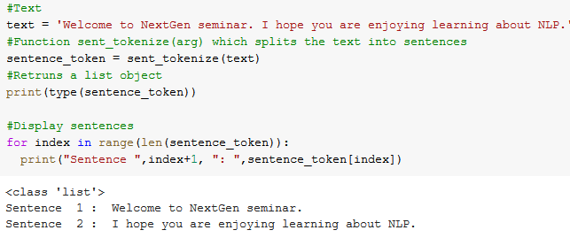
Tokenization …

Slide 17
Stemming
“Stemmers remove morphological affixes from words, leaving only the word stem.” In short, removing ‘extras’ from a word and reduce it to its basic root.
Example: beautiful → beauty , dies → die, flying → fly, mules → mule
OverStemming: stemming a word when non-necessary (frequent problem).
Universal→ Universe , University → Universe
Porter Stemmer: common stemmer used, although it is not the most precise, better stemmers exist, but it is useful for basic stemming needs.
Notes:
Given these are automated methods, sometimes words can can change and not reflect their true meaning in a sentence

Slide 18
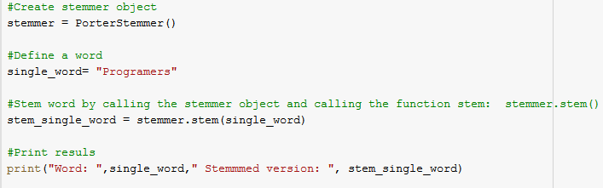
Stemming ...

Slide 19
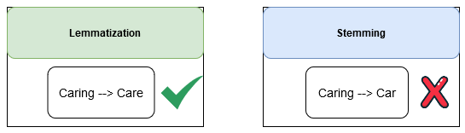
Lemmatization
Similar task to stemming, in the sense that we are modifying a word to its root, but with the difference that in this scenario the change is based on “meaning” rather than affixes. Similar words that have similar meaning are considered equal.
Example: verbs in the past tense are changed to the present (went → go), synonyms are unified (best → good).
Efficiency of this libraries is based on the dictionaries (vocabulary) that they use.

Slide 20
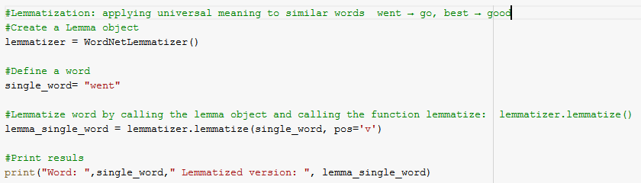
Lemmatization...

Slide 21
Stop Words
“Stop Words are words which do not contain important significance to be used in search queries. Usually, these words are filtered out from search queries because they return a vast amount of unnecessary information.
Example: words that are commonly used in the English language such as 'as, the, be, are' etc.
Each programming language will give its own list of stop words to use, and you can always add more stop words, or create your own customized version.

Slide 22
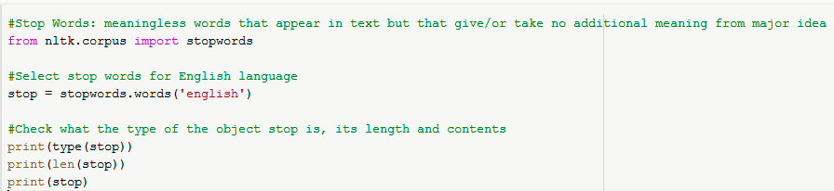
Stop Words...

Slide 23

Part of Speech Tagging (POS)
“A Part-Of-Speech Tagger (POS Tagger) is a piece of software that reads text in some language and assigns parts of speech to each word (and other token), such as noun, verb, adjective, etc.,”
Example: “I am eating an apple.” → [(I,PRP), (am, VPB), (eating, VBG),(an,DT), (apple, NN)]

Slide 24
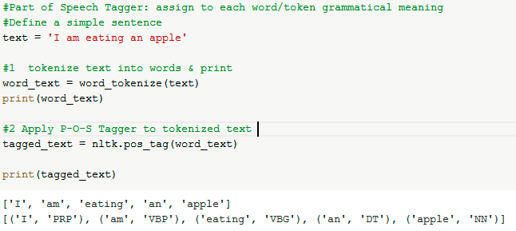
Part of Speech Tagging (POS)...

Slide 25
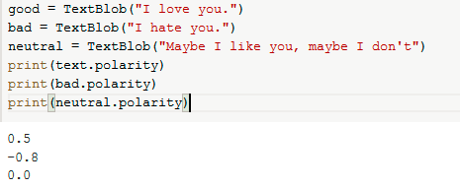
Sentiment Analysis
“Sentiment analysis is a machine learning technique that detects polarity (e.g. a positive or negative opinion) within text, whether a whole document, paragraph, sentence, or clause.”
Examples

Slide 26
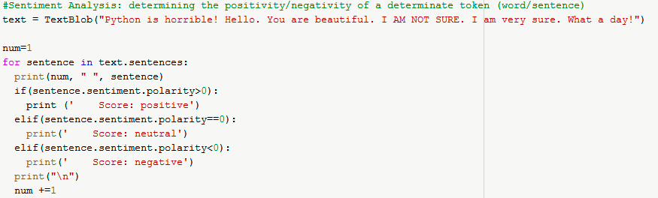






Sentiment Analysis...

Slide 27
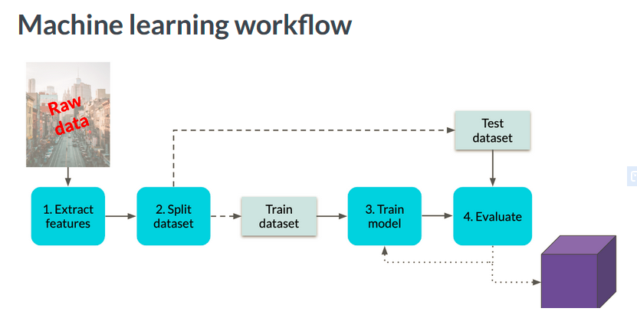
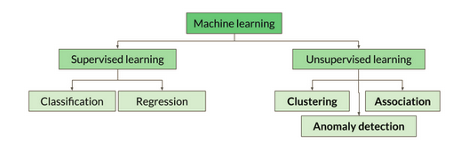
ML & NLP
Model Type

Slide 28
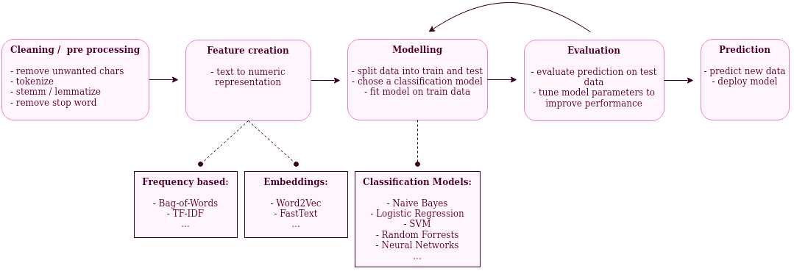
Typical NLP Workflow
Source: https://data-dive.com/german-nlp-binary-text-classification-of-reviews-part1

Slide 29
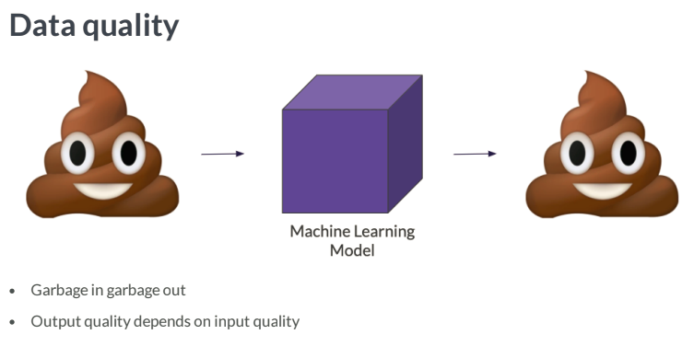
The challenge
Slide Source: datacamp.com

Slide 30

TayTweets the broken A.I.

Slide 31
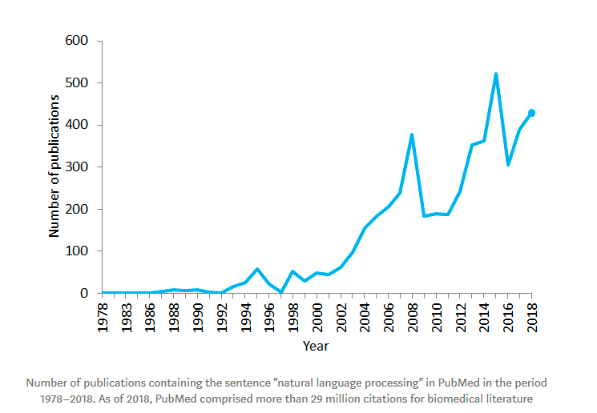
The Future
PubMed: 30 million biomedical citations/articles
-Big Data → need for structure and meaning → NLP.
-Safe to conclude that as long as we will be dependent on Data, NLP is part of the process that allows for mass discoveries in an effortless manner.

Slide 32
Conclusion
NLP is a subfield of ML that overlaps with other fields such as linguistics & C.S.
NLP techniques are very powerful and used in a variety of different fields/scenarios: ……
NLP aims at solving complex problems, and as a result big challenges and responsibilities comes as well. We should ensure quality control at every step.
NLP is not just today’s reality, but tomorrow’s destiny as well.

Slide 33
Thank You!

Slide 34
References
TowardDS-https://towardsdatascience.com/your-guide-to-natural-language-processing-nlp-48ea2511f6e1
SAS-https://www.sas.com/en_us/insights/analytics/what-is-natural-language-processing-nlp.html
NLPFlow-https://data-dive.com/german-nlp-binary-text-classification-of-reviews-part1
MonkeyLearn- https://monkeylearn.com/sentiment-analysis/
YT-https://www.youtube.com/watch?v=Lr4yi9onykg
Book-https://www.nltk.org/book/
Notes:
Remove: POS, Bag of Words. Add: Feature Engineering, Column Vectorizer , Google Collab

